Slide 1
Development
The Statutory Definition of “Development”
“The carrying out of building, engineering, mining or other operations in, on, over or under land; or the making of any material change in the use of buildings or other land”.
Town and Country Planning Act 1990 Section 55
Works that do not comprise development include, but are not limited to:
- interior alterations
- building operations which do not materially affect the external appearance of a building.
- a change use of land or buildings, where the before and after use falls within the same use class.

Slide 2
Permitted Development
ALL DEVELOPMENT NEEDS A PLANNING PERMISSION
BUT development which is “permitted” under the General Permitted Development Order (“PD”) gets a DEEMED PLANNING PERMISSION (LPAs grant “express” planning permissions)
these rights apply nationally (but are restricted in some areas, e.g. Conservation Areas but NOT in the Green Belt)
they can be removed by the Authority (by condition or “Article 4 Directions”) - if there are good reasons

Slide 3
Permitted Development cont…
19 Parts and numerous Classes covering a wide range of development
may be subject to conditions, as with a “normal” planning permission
“notification” of some forms of development (agriculture, telecoms, larger home extensions, some change of use) to see if planning permission is needed or to consider a limited set of criteria
Examples:
house extensions, walls and fences, garages etc.
temporary buildings and use
agricultural buildings and operations
some material changes of use
minor works by statutory undertakers

Slide 4
Schedule 2, Part 1, Classes A – H Development within the curtilage of a dwelling house
Class A- Enlargement, improvement or other alteration of a dwellinghouse
Class B- Additions etc to the roof of a dwellinghouse
Class C- other alterations to the roof of a dwellinghouse
Class D- Porches
Class E- buildings etc incidental to the enjoyment of the dwellinghouse
Class F- Hard surfaces incidental to the enjoyment of a dwelling house
Class G- Chimneys, flues etc on a dwellinghouse
Class H- microwave antenna on a dwellinghouse

Slide 5
Class A-
Enlargement, improvement or other alteration of a dwellinghouse
Types of extensions and alterations permitted:
single and two storey rear extension (including conservatories)
Prior Notification for single storey larger house extensions
Detached House- between 4-8 metres
Any other houses- Between 3-6 metres
Single storey side extensions
Insertion or new Windows and doors

Slide 6
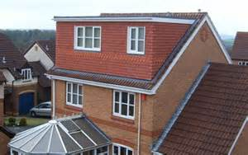
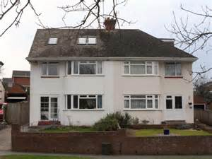
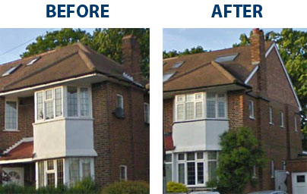
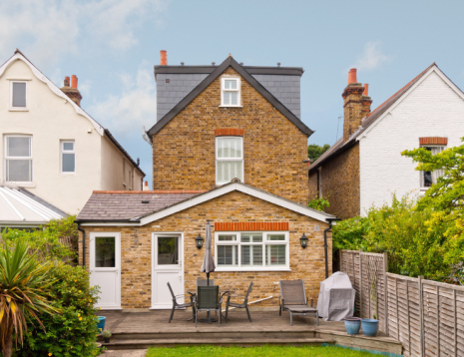
Class B- Additions etc to the roof of a dwellinghouse
Includes:
Dormer Windows
Hipped to gable extensions
Restrictions- volume, can’t be on principal elevation and front a highway and can’t exceed height of the existing roof.

Slide 7
Class C- other alterations to roof of a dwellinghouse
This Class covers things such as rooflights
Development is not permitted by Class C if—
the alteration would protrude more than 0.15 metres beyond the plane of the slope of the original roof when measured from the perpendicular with the external surface of the original roof;
it would result in the highest part of the alteration being higher than the highest part of the original roof; or
it would consist of or include—
(i) the installation, alteration or replacement of a chimney, flue or soil and vent pipe, or
(ii) the installation, alteration or replacement of solar photovoltaics or solar thermal equipment.
Conditions of Class C
any window located on a roof slope forming a side elevation of the dwellinghouse must be—
(a) obscure-glazed; and
(b) non-opening unless the parts of the window which can be opened are more than 1.7 metres above the floor of the room in which the window is installed.

Slide 8
Class D- Porches
Adding a porch to any external door of your house is can be permitted development, provided the following limits and conditions area met:
Ground area of porch (measured externally) not to exceed 3 square metres
2. Highest part of porch not to exceed 3 metres
3. No part of porch to be within 2 metres of any
boundary that fronts a highway

Slide 9
Class E- Buildings etc incidental to the enjoyment of the dwellinghouse
The building must be Incidental- non habitable
shed, garage, green house, summer house, swimming or other pool or a container used for domestic heating purposes for storage of oil or gas.
Can not include habitable accommodation: Bedroom, Kitchen, bathroom
Can’t be forward of a wall forming principal elevation (of original house)
Can’t cover more than 50% of curtilage (subject to it remaining incidental in size)
Can’t exceed more than 4 metres in height – if within 2metres of boundary can only be 2.5metres.
Eaves height can’t exceed 2.5metres in all cases
Can’t be built within the curtilage of a listed building
Please Note: Conversion of existing outbuildings may not be development

Slide 10
Other Classes and matters:
Class F- Hard surfaces incidental to the enjoyment of a dwelling house
Class G- Chimneys, flues etc. on a dwellinghouse
Class H- microwave antenna on a dwellinghouse
Raised platform
Balconies

Slide 11
Part 2 Minor Operations
Class A- The erection, construction, maintenance, improvement or alteration of a gate, fence, wall or other means of enclosure
Class B- Means of access to a highway (unclassified road)
Class C- Exterior painting

Slide 12
Part 14- Renewable Energy on domestic premises
Class A and B– installation of solar equipment
Class C – installation or alteration etc of ground source heat pumps
Class D – installation or alteration etc of water source heat pumps
Class E – installation or alteration etc of flue for biomass heating system
Class F – installation or alteration etc of flue for combined heat and power
Class G – installation or alteration etc of air source heat pumps
Class H and I – installation or alteration etc of wind turbine

Slide 13
Dwellinghouses- C3 Use Class
Uses as a dwellinghouse (whether or not as main residence) by:
A single person or by people to be regarded as forming a single household;
Not more than 6 residents living together as a single household where care is provided for residents; or
Not more than 6 residents living together as a single household where no care is provided to residents
PD change to C4- Houses in multiple Occupancy

Slide 14
C4- Houses in multiple Occupancy
Use of a dwellinghouse by 3-6 residents (unrelated) as a house in multiple occupation (HMO)
Large HMOs -
(more than 6 residents (unrelated)) are classified as sui generis

Slide 15
Change of uses to dwellings C3
Class G- retail or betting office or pay day loan shop to mixed use (with up to 2 flats)
Class L- Small HMOs to dwellinghouses and vice versa
Class M- retail, takeaways and specified sui generis uses to dwellinghouses (subject to prior approval)
Class N- specified sui generis uses to dwellinghouses (subject to prior approval)
Class O- offices to dwellinghouses (subject to prior approval)
Class P- Storage or Distribution centre to dwellinghouses (subject to prior approva)
Class PA- premises in light industrial use to dwellinghouse (subject to prior approval)
Class Q- Agricultural buildings to dwellinghouses (subject to prior approval)
Useful link: https://lichfields.uk/media/2913/guide-to-use-classes-order-in-england.pdf

Slide 16
Any Questions?
Useful Information and links:
www.planningportal.co.uk (Interactive guides: https://interactive.planningportal.co.uk/)
https://www.gov.uk/government/publications/permitted-development-rights-for-householders-technical-guidance (Government Technical Guidance for Householders)
Contacts:
01527 881770
newplan@bromsgroveandredditch.gov.uk

